Slide 1


React JS
(Styling)
Lecture-13

Slide 2
Today’s Agenda
Styling In React
Different Ways Of Styling
External StyleSheet
Inline Styling
JS Object Styling
Exercises

Slide 3
Styling In React
When it comes to styling our React app, we have a tons of different options.
In this session we will explore three of the most common ways to style a React App .
These are:
External Stylesheet
Inline Styling
Styling Using JS Object

Slide 4
External CSS StyleSheet
Writing CSS in a stylesheet is probably the most common and basic approach to styling a React application.
Following are the steps:
Write the CSS styling in a separate file
Save the file with the .css file extension and conventionally with the same name as the component.
Finally we use <link> tag in the index.html page to load that css file

Slide 5
Example
To demonstrate using External StyleSheet we will use the Student application and style the <div> element.
So now the app will have 4 files:
Student.css with a css class called .Student for styling div
Student.js with a className attribute added to <div>
App.js
index.html with a <link> tag referring to Student.css

Slide 6
External CSS StyleSheet
Student.css
.Student {
background-color: bisque;
border-radius: 20px;
border: solid 2px brown;
font-family: "Titillium Web", sans-serif;
}

Slide 7
External CSS StyleSheet
Student.js
class Student extends React.Component {
. . . . . .
. . . . . .
render() {
. . . . . . .
return (
<div className="Student">
. . . . . . .
}
}

Slide 8
External CSS StyleSheet
index.html
<!DOCTYPE html>
<html lang="en">
<head>
<script . . . . . .>></script>
<script . . . . . .>></script>
<link type="text/css" href="Student.css" rel="stylesheet" />
<link
href="https://fonts.googleapis.com/css2?family=Titillium+Web:wght@300&display=swap"
rel="stylesheet"
/>
<title>Using External StyleSheet</title>
</head>
<body>
<div id="root"></div>
<script type="text/babel" src="Student.js"></script>
<script type="text/babel" src="App.js"></script>
</body>
</html>

Slide 9
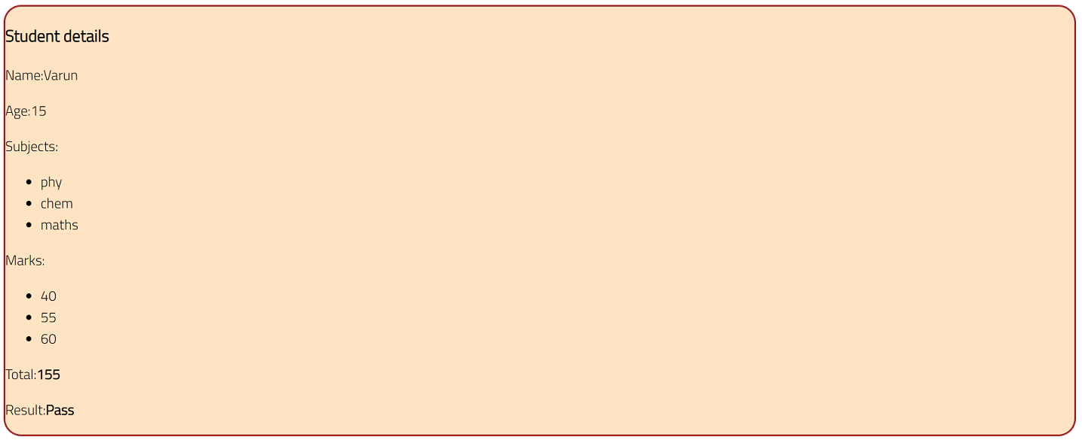
Output

Slide 10
Inline Styles
We can add inline styles to any React component we want to render.
These styles are written as attributes and are passed to the element
Syntax:
<tag style={ { key:”value”, key:”value”, . . . .}} >

Slide 11
Points To Remember
Here are some things we should note about this.
First, there are two curly brackets.
What we are rendering is written in JSX, and, for pure JavaScript expressions to be used in JSX, they have to be included in curly brackets.
The first curly bracket injects JavaScript into JSX.
The inner curly brackets creates an object literal.
The styles are passed as object literals to the element.

Slide 12
Points To Remember
Second, in React, inline styles are not specified as a string
Instead they are specified with an object whose key is the camelCased version of the style name, and whose value is the style’s value, specified as a string.

Slide 13
Example
To demonstrate using Inline Styles we will use the same Student application and style the <div> element.
So now the app will have 3 files:
Student.js with a style attribute added to <div>
App.js
index.html

Slide 14
Inline Styles
Student.js
class Student extends React.Component {
. . . . . .
. . . . . .
render() {
. . . . . . .
return (
<div
style={{
backgroundColor: "bisque",
borderRadius: "20px",
border: "solid 2px brown",
fontFamily: '"Titillium Web", sans-serif',
}}
. . . . . . .
}
}

Slide 15
Inline Styles
index.html
<!DOCTYPE html>
<html lang="en">
<head>
<script . . . . . .>></script>
<script . . . . . .>></script>
<link
href="https://fonts.googleapis.com/css2?family=Titillium+Web:wght@300&display=swap"
rel="stylesheet"
/>
<title>Using Inline Styles</title>
</head>
<body>
<div id="root"></div>
<script type="text/babel" src="Student.js"></script>
<script type="text/babel" src="App.js"></script>
</body>
</html>

Slide 16
Using JS Objects
Inline styles are good if we just want to add a few properties to the elements .
However, imagine we had to add more and more styles to the element.
This is where the inline method breaks down because it will not look clean.

Slide 17
Using JS Objects
As a solution we can create object variables and pass them to the elements.
We create a style object variable the same way we create a JavaScript object.
This object is then passed to the style attribute of the element we want to style.

Slide 18
Example
To demonstrate using JS Object we will use the same Student application and style the <div> element.
So now the app will have 4 files:
Student.js with a <style> attribute added to <div>
App.js
index.html

Slide 19
Using JS Objects
Student.js
class Student extends React.Component {
const studentStyle = {
backgroundColor: "bisque",
borderRadius: "20px",
border: "solid 2px brown",
fontFamily: '"Titillium Web", sans-serif',
};
render() {
. . . . . . .
return (
<div
style={studentStyle}
. . . . . . .);
}
}

Slide 20
Using JS Objects
index.html
<!DOCTYPE html>
<html lang="en">
<head>
<script . . . . . .>></script>
<script . . . . . .>></script>
<link
href="https://fonts.googleapis.com/css2?family=Titillium+Web:wght@300&display=swap"
rel="stylesheet"
/>
<title>Using Inline Styles</title>
</head>
<body>
<div id="root"></div>
<script type="text/babel" src="Student.js"></script>
<script type="text/babel" src="App.js"></script>
</body>
</html>

Slide 21
Output

Slide 22
Exercise
Modify the previous app so that if the student has passed then the Result must have limegreen background and if he has failed then the background should be crimson

Slide 23
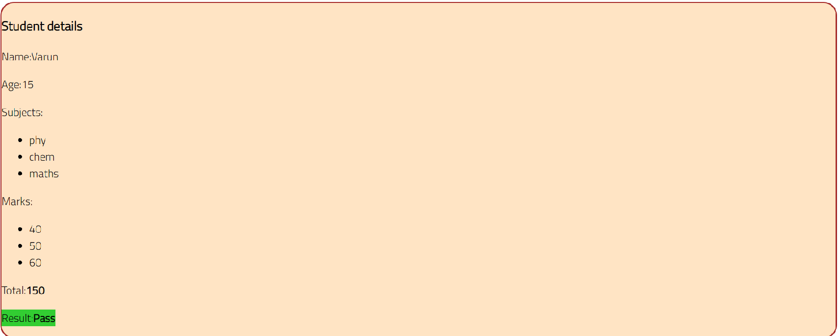
Desired Output

